Slide 1


Lead-Based Paint Hazard Control
Madison County Community Development
Alan Dunstan, Madison County Board Chairman
Frank Miles, Administrator

Slide 2
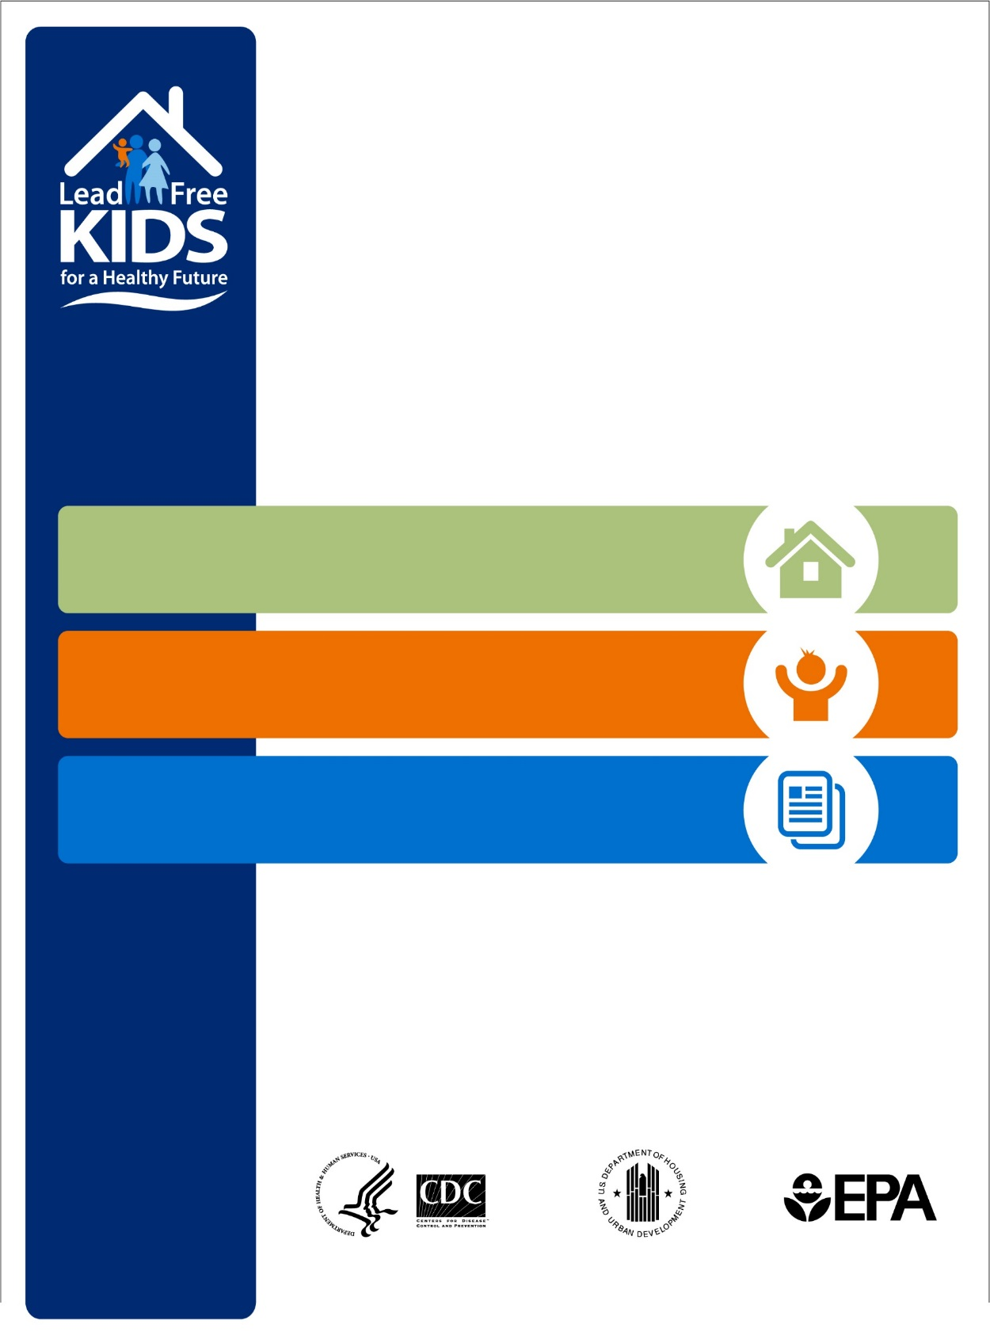

NATIONAL
LEAD POISONING
PREVENTION WEEK
NATIONAL
LEAD POISONING
PREVENTION WEEK
OCTOBER 25-31, 2015
Get Your Home Tested
618-296-4383 Madison County’s Lead Program
Get Your Child Tested
618-692-8954 Madison County Health Dept.
Get the Facts
1-800-424-LEAD(5323) National Lead Hotline
cdc.gov/nceh/lead
hud.gov/lead
epa.gov/lead

Slide 3
Sources of Lead
Paint ~ Deteriorated lead-based paint commonly found in older housing is the most common source of lead in children with higher blood lead levels.
Soil
Industrial Releases

Slide 4
Lead In and Around the Home
On homes built prior to 1978
Windows
Doors
Porches
Walls
Exterior Trim
Garages/Sheds
Friction/Impact Surfaces

Slide 5
Lead in the Body
Children with elevated lead levels in their bodies can suffer from:
Damage to the brain & nervous system which results in lower IQ
Affects a child’s ability to think, learn, or behave
Slowed growth
Hearing problems
Headaches
Children who appear healthy can have dangerous levels of lead in their bodies.

Slide 6
Effects continued…
Lead is also harmful to adults.
Pregnant women exposed to lead can transfer lead to their fetuses.
Children can swallow lead dust as they eat, play, and do other normal hand-to-mouth activities.
People consume lead in a variety of ways
A blood test is the only way to find out if you or a family member already has lead in their system.

Slide 7
Facts About Lead-Based Paint
Lead-based paint was used in more than 38 million homes until it was banned for residential use in 1978.
Projects that disturb painted surfaces can create dust and endanger you and your family.
Illinois law requires health provider to obtain a blood lead test or to apply a targeted blood lead testing approach.

Slide 8
Eligibility Requirements for
Madison County’s Lead Program
  Units built prior to 1978.
  Must have a child under 6 years old residing in the home or visiting the home at least 30 hours in a calendar year; or a pregnant woman living in the home.
  Landlords contribute 10% of lead hazard control work unless they are within the income guidelines.
  Occupants must meet income guidelines.

Slide 9
Income Guidelines at or below 80% of the area median income level:
Household Size Gross Annual Income
  1 $39,400
  2 $45,000
  3 $50,650
  4 $56,250
  5 $60,750
  6 $65,250
  7 $69,750

Slide 10
Landlord Requirements
Owner of rental units may not evict tenant without legal cause for 12 months after the final inspection.
If the current tenant moves out, the owner must agree to:
  Rent to low-income tenants for 3 years after lead hazard control work is completed with priority given to families with children under the age 6.

Slide 11
Program Process
Occupant applies at MCCD’s office in Edwardsville
After eligibility is determined, a Lead Inspection Risk Assessment is conducted which determines the lead based paint hazards on each unit.
Work specifications are generated from that report.

Slide 12
Program Process continued…
Job is given to a lead licensed contractor to perform lead hazard control activities.
The contractor calls for a clearance once the job is complete.
A final inspection is conducted by one of Madison County Community Development’s inspector to ensure completion and quality of work.

Slide 13
Typical Lead Hazard
Control Activities:
Replacement of:
Windows
Doors
Soffit & Fascia
Siding
Porch Areas

Slide 14
EPA Requires
Renovators / Contractors must give The Lead-Safe Certified Guide To Renovate Right pamphlet to homeowners and tenants before starting work. The homeowner is required to sign off indicating the renovator provided the pamphlet.

Slide 15
For More Information on these rules:
National Lead Clearing House
  1-800-424-LEAD (5323)
USEPA’s Website
  http://www.epa.gov/lead

Slide 16
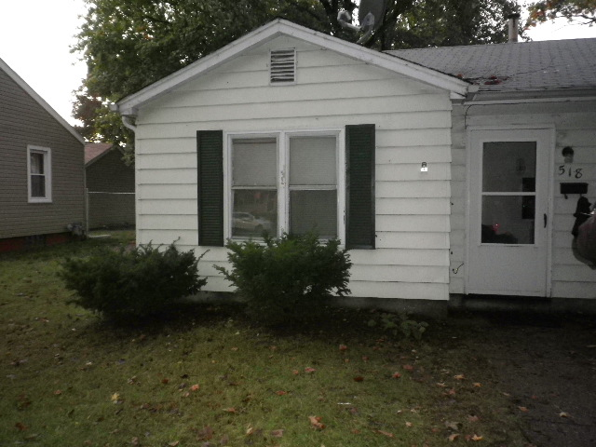
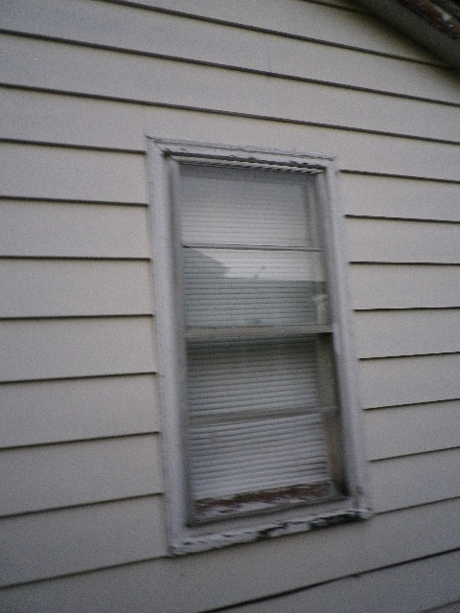
Windows

Slide 17
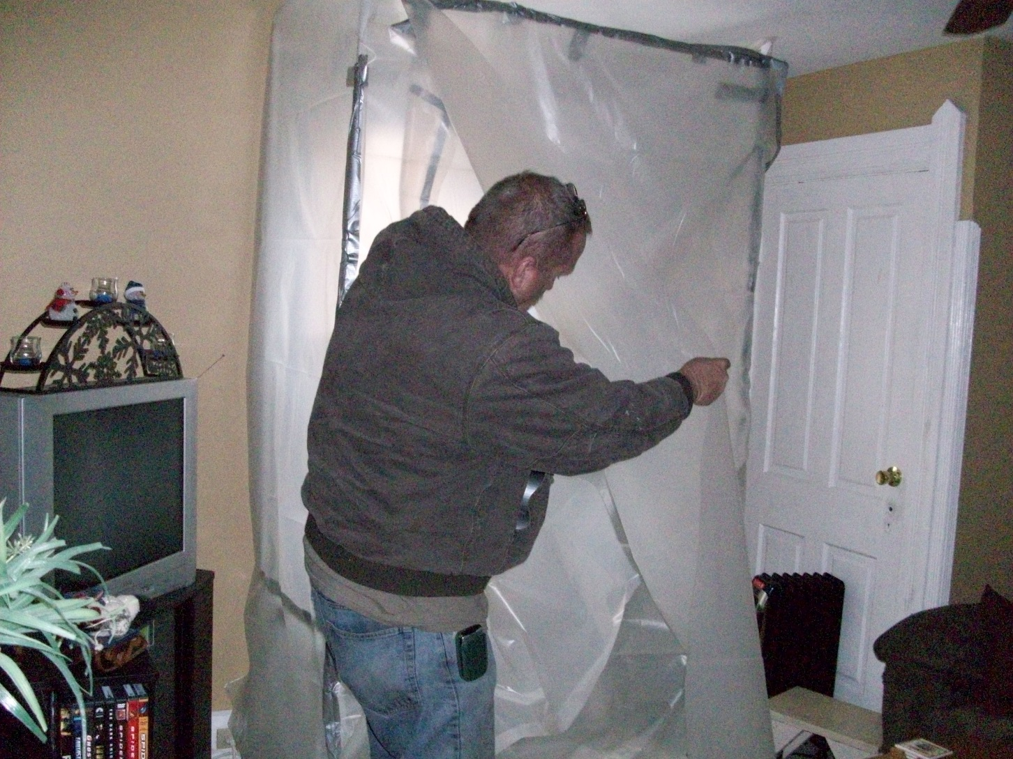
Lead-Based Paint Containment

Slide 18
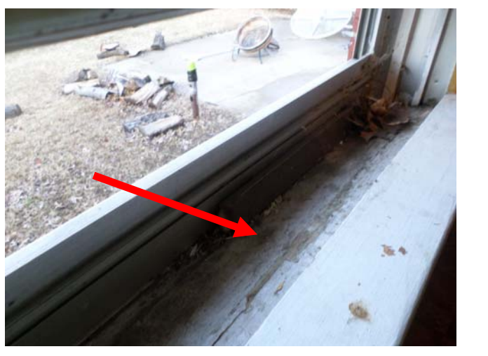
Typical Window Exterior Trough

Slide 19
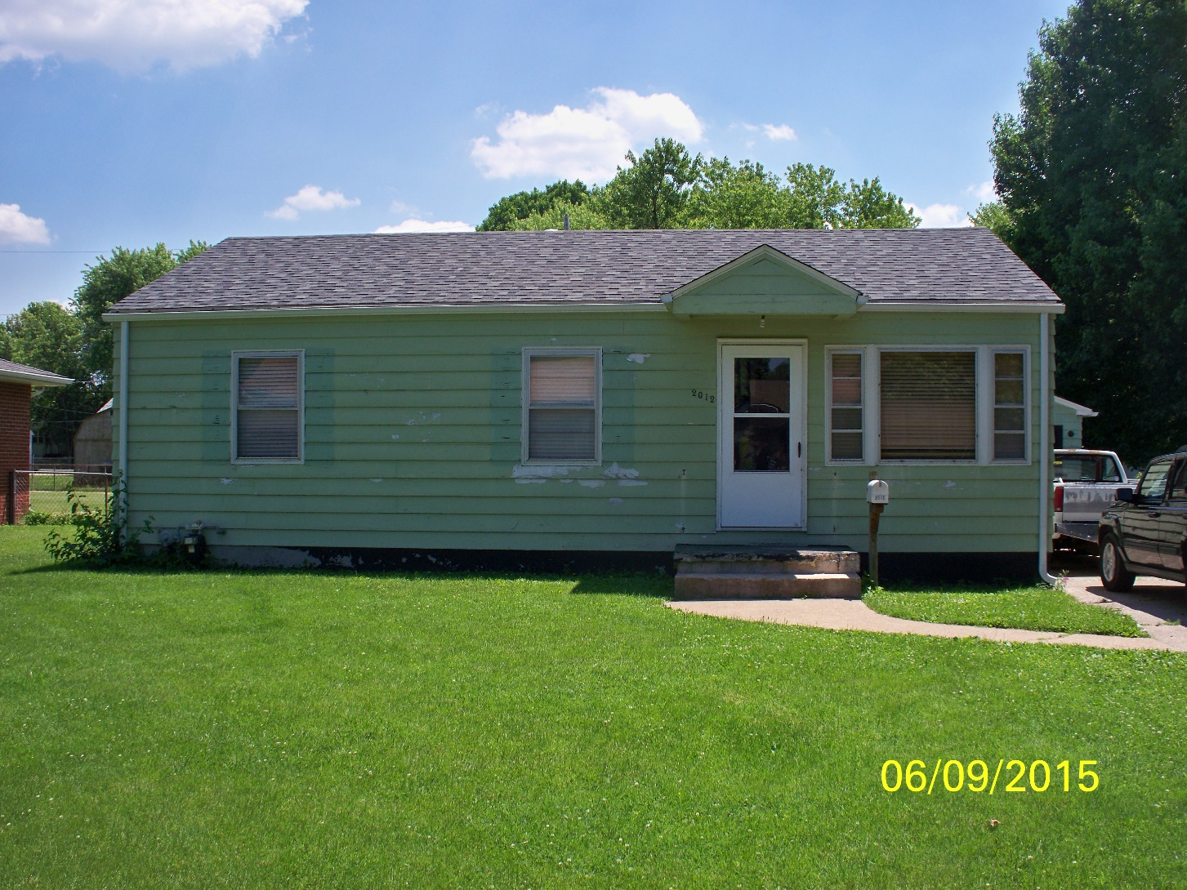
Before Lead-Based Paint Remediation

Slide 20
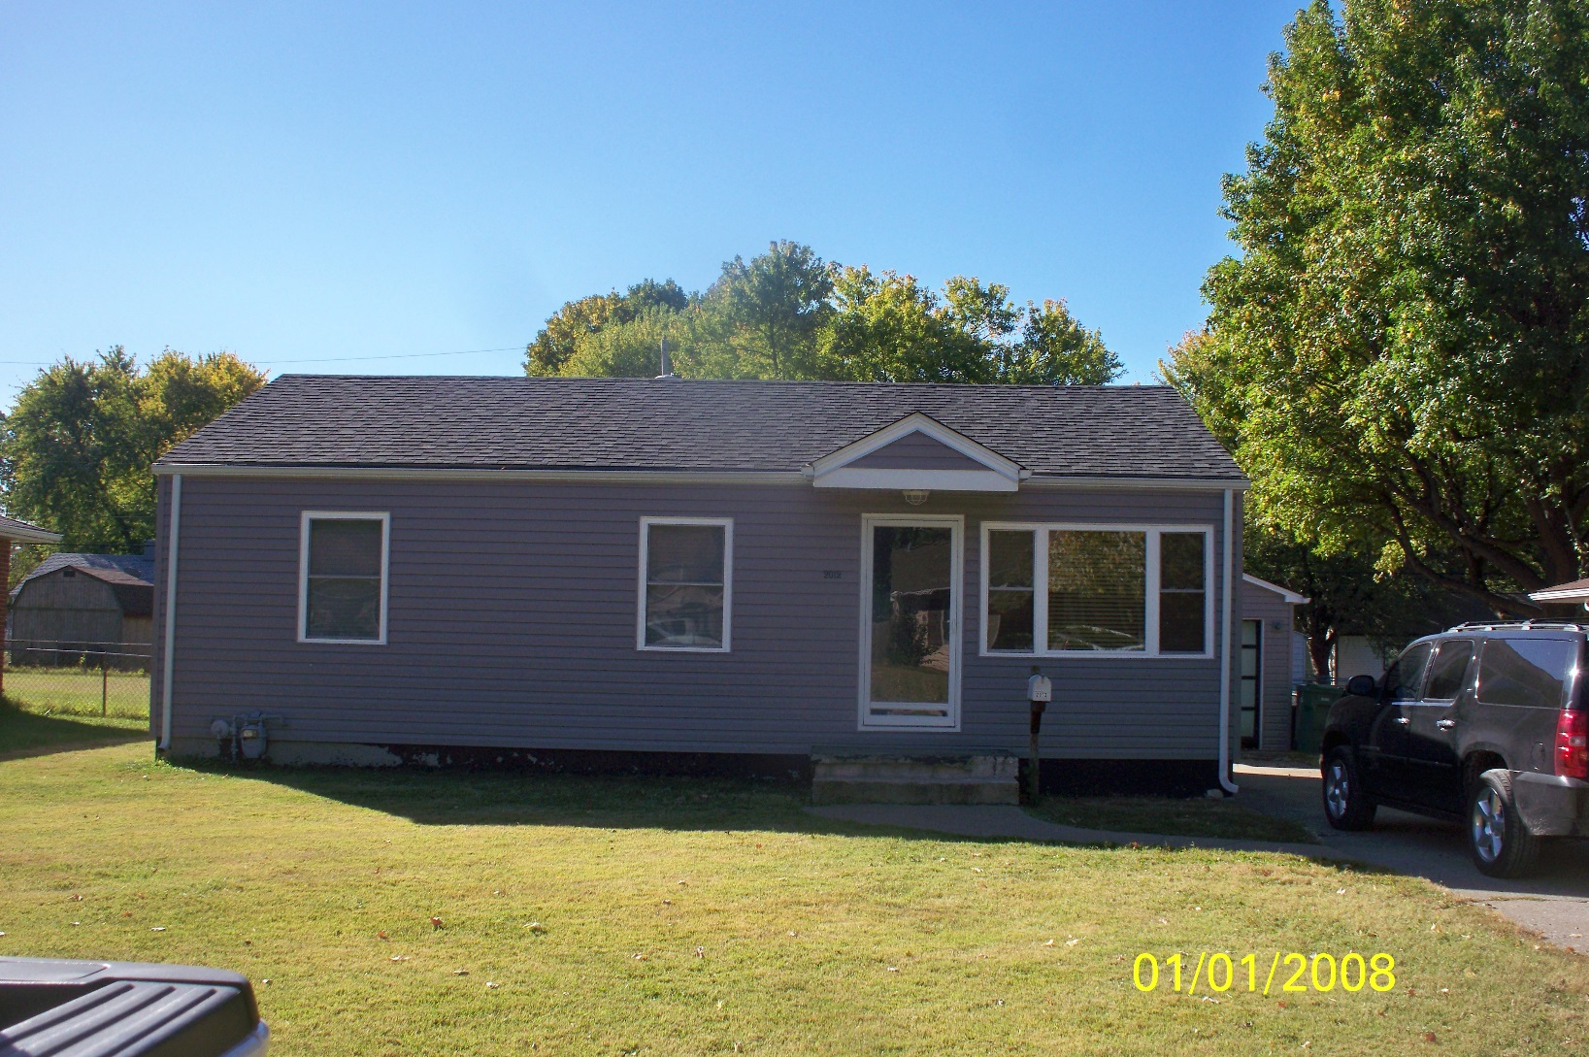
After Lead-Based Paint Remediation

Slide 21
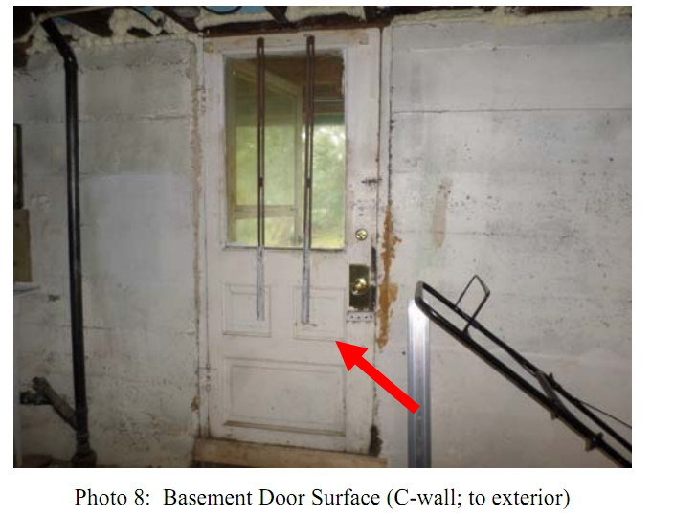
Basement

Slide 22
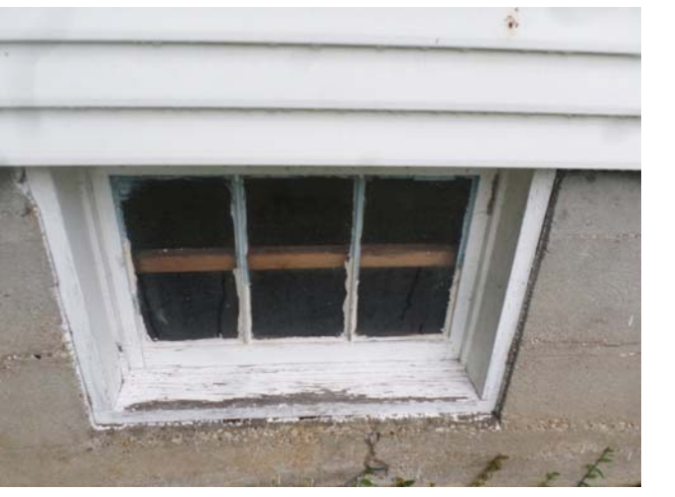
Basement Window

Slide 23
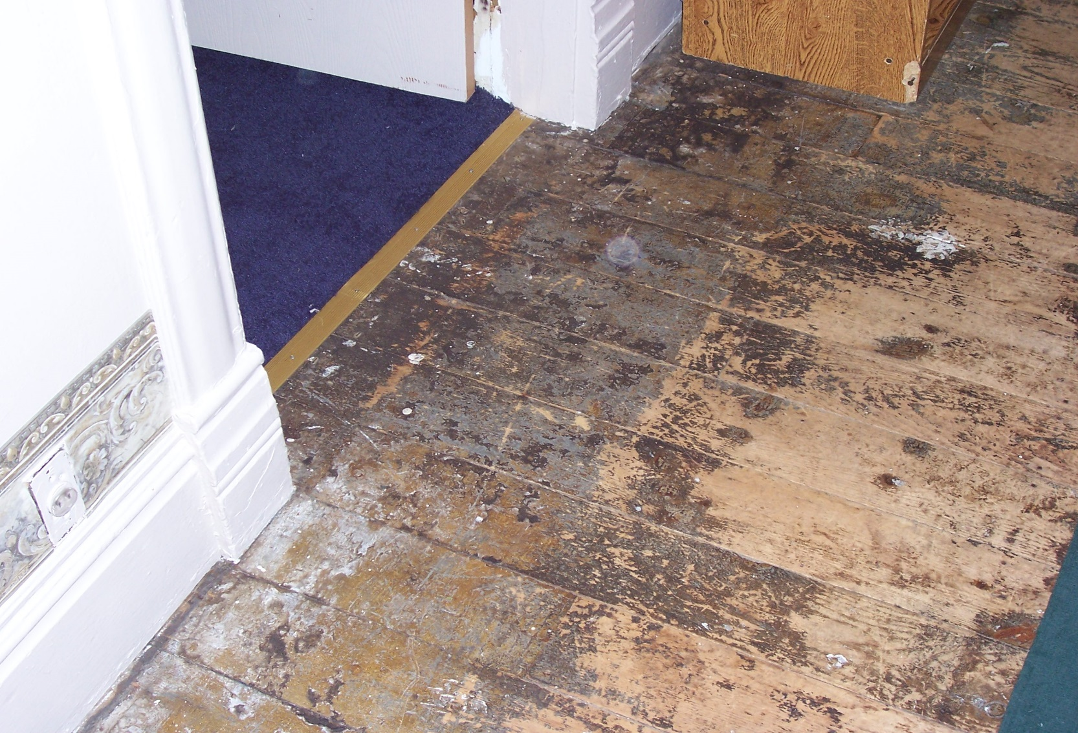
Floor

Slide 24
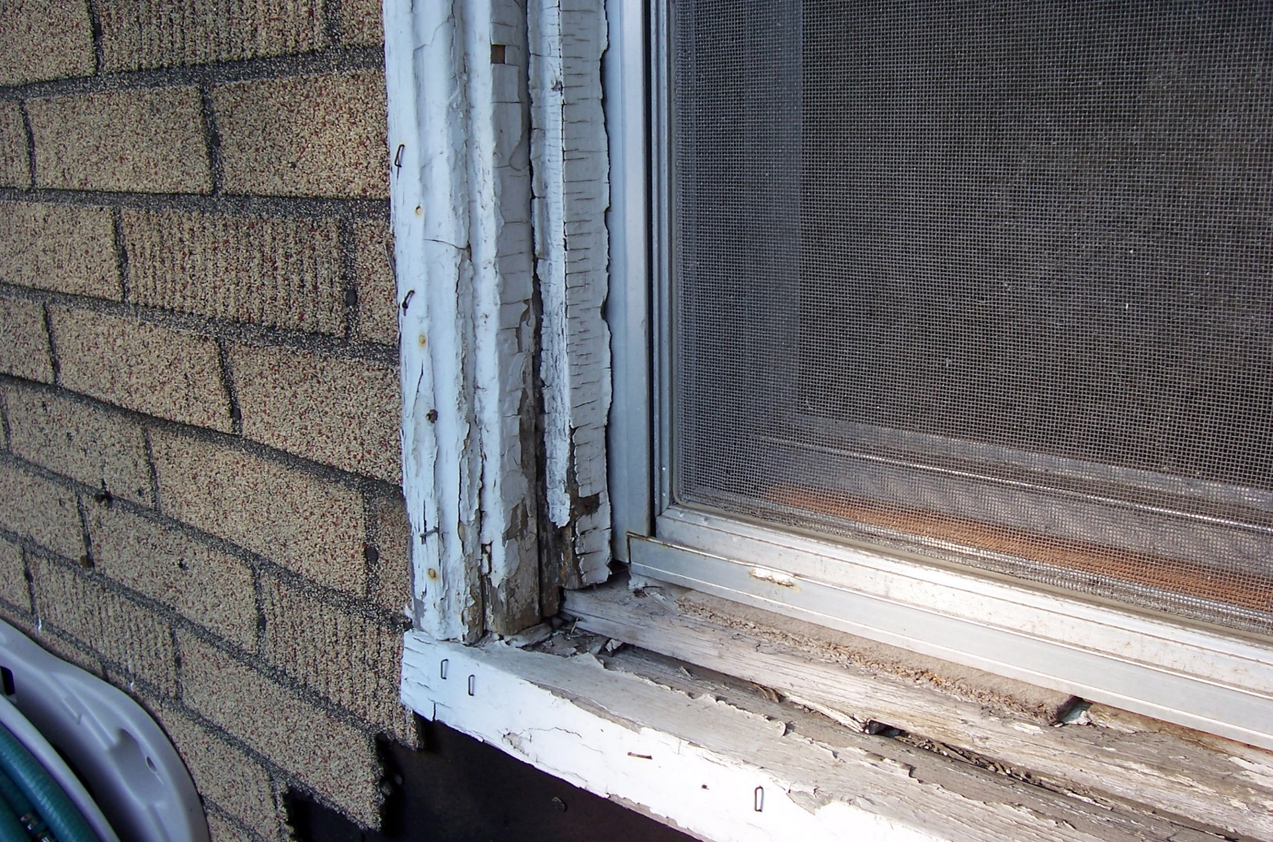
WINDOW

Slide 25
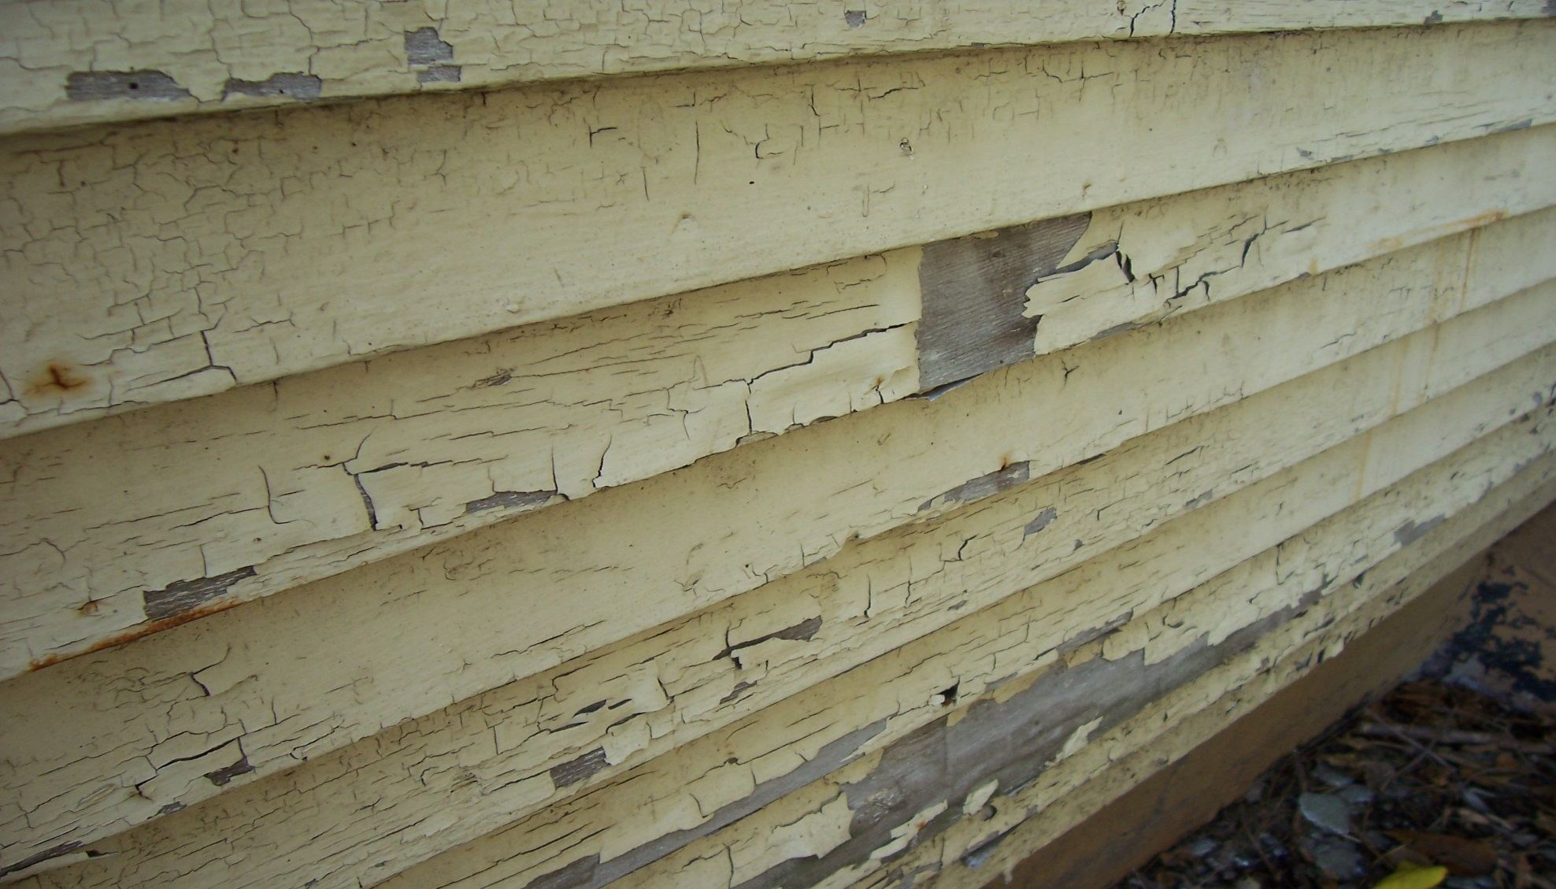
SIDING

Slide 26
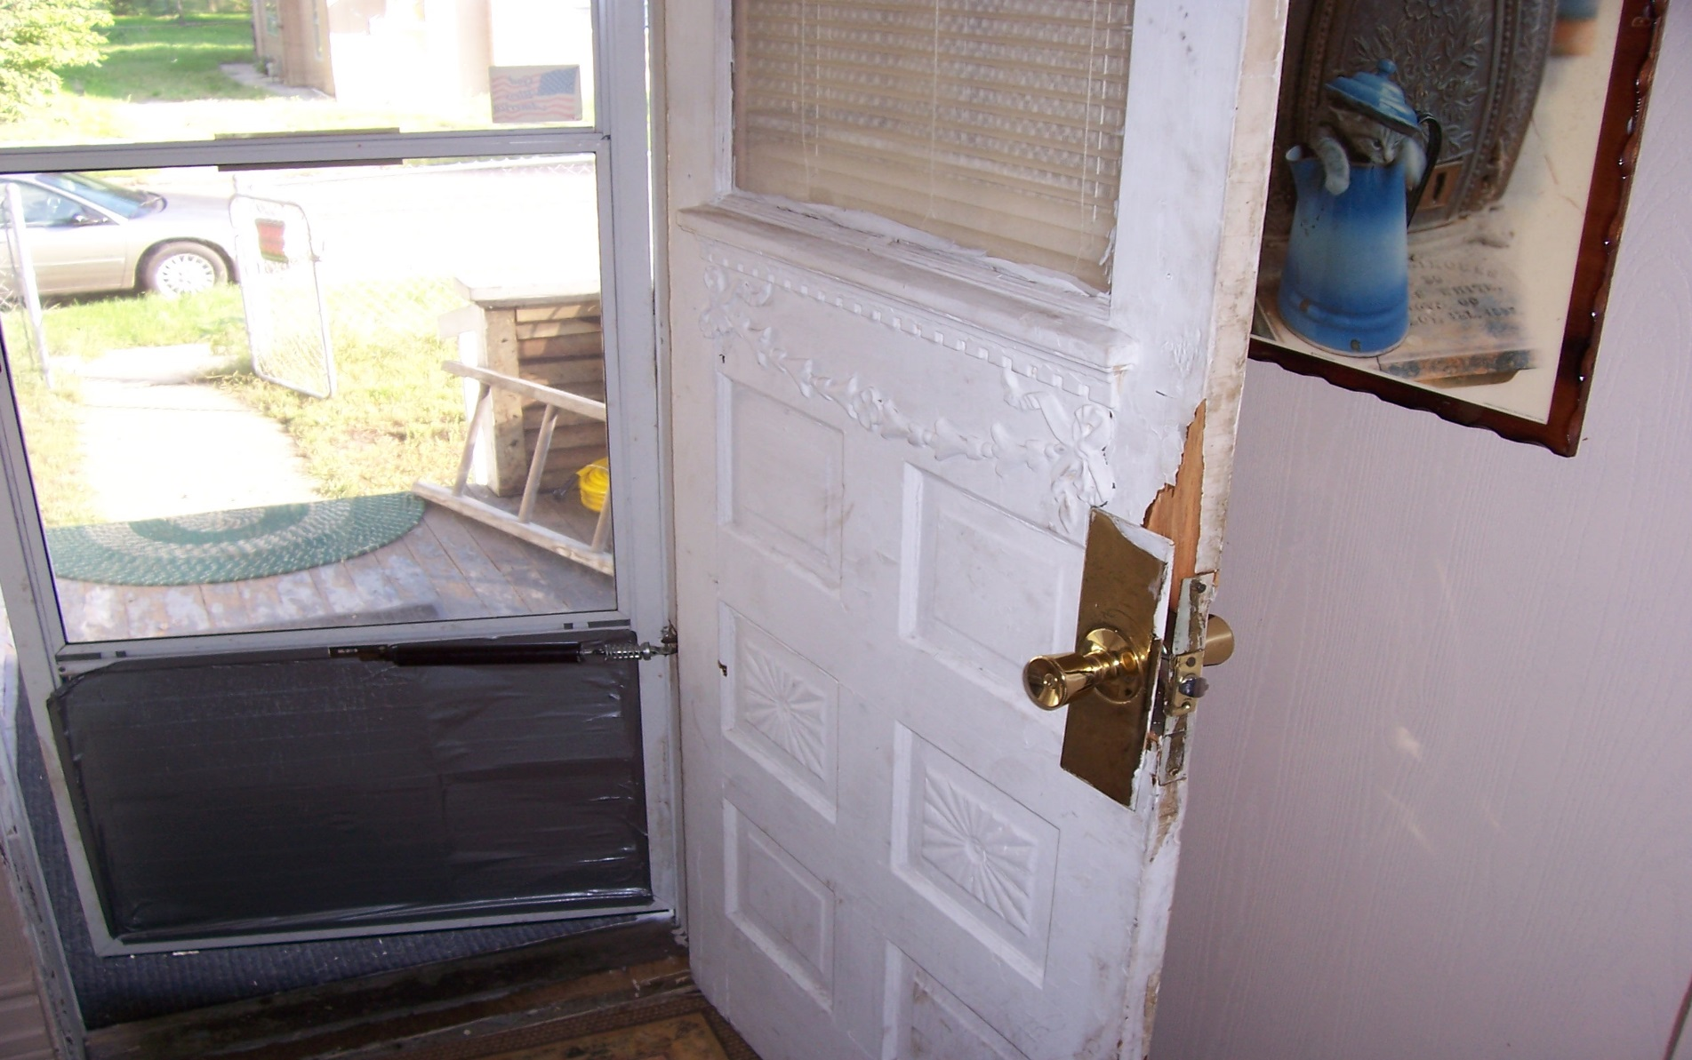
DOOR

Slide 27
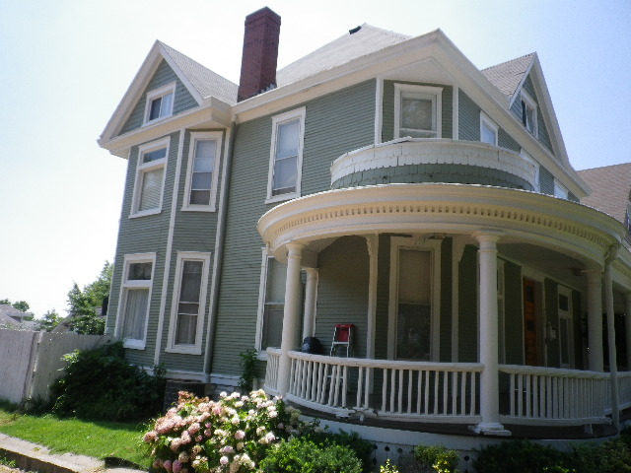
HISTORICAL HOUSE

Slide 28
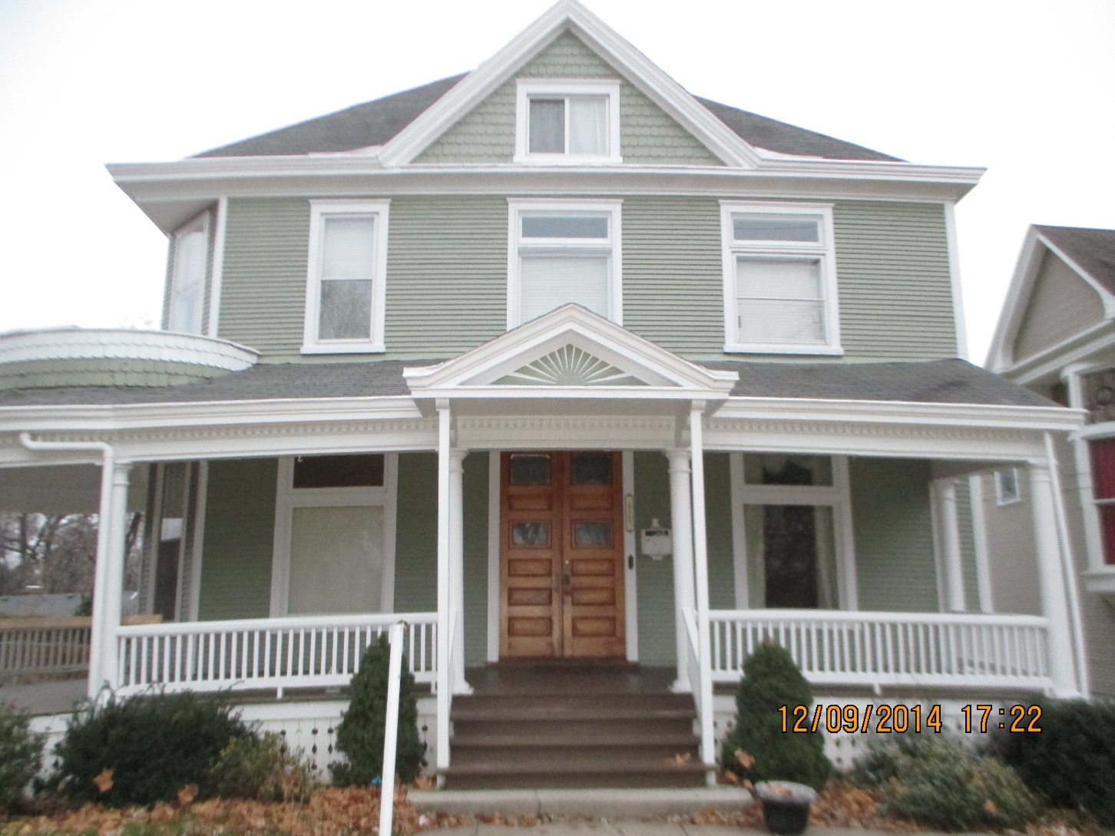

Slide 29
Questions???

Slide 30
CONTACT
Madison County’s Lead Program
David Goodrich, Coordinator
Peggy Dugger, Planner
130 Hillsboro Ave.
Edwardsville, IL 62025
618-296-4383

Slide 31
It’s the Law
Federal law requires that individuals receive certain information before renovating more than six square feet of painted surfaces in a room for interior projects or more than twenty square feet of painted surfaces for exterior projects or window replacement or demolition in housing, child care facilities and schools built before 1978. Always ask to see the contractor’s certification.

